Slide 1
A Poet’s Life: Biographies of the Poets
When “home” is more than just a place: Poetry as a tool to understand contemporary Israeli society and ourselves
Elana Ackerman Hirsch

Slide 2
Unit 1 Poets

Slide 3
Leah Goldberg: 1911-1970
Born in East Russia in 1911 and grew up in Kovno, Lithuania where she began writing poetry in Hebrew at the age of 12.
Goldberg was a brilliant scholar who spoke seven languages. She received her PhD in Semitic studies in 1933, and then by 1935, moved to Tel Aviv.
Goldberg wrote poetry, literary criticism, children’s books and even translated European literature into Hebrew.
Goldberg chose to write about her personal life and themes, rather than about politics.
She is one of the great poets of modern Hebrew literature.
Notes:
Harel, Ma'ayan. "Lea Goldberg." Shalvi/Hyman Encyclopedia of Jewish Women. 31 December 1999. Jewish Women's Archive. (Viewed on March 19, 2022) <https://jwa.org/encyclopedia/article/goldberg-lea>.

Slide 4
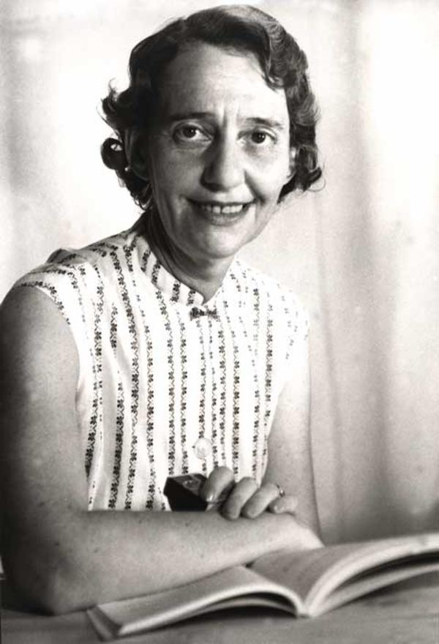
Notes:
Harel, Ma'ayan. "Lea Goldberg." Shalvi/Hyman Encyclopedia of Jewish Women. 31 December 1999. Jewish Women's Archive. (Viewed on March 19, 2022) <https://jwa.org/encyclopedia/article/goldberg-lea>.

Slide 5
Shaul Tchernichovsky: 1875-1943
Born in a village between Crimea and the Ukraine in 1875.
He grew up in the countryside, away from other Jews.
Tchernichovsky did receive some Hebrew training, but he went to state schools and attended medical school in Heidelberg, Germany.
After living across Europe and the United States, he eventually moved to Tel Aviv in 1931.
Tchernichovsky translated great works of literature (The Iliad, The Odyssey, The Epic of Gilgamesh, as well as Shakespeare) into Hebrew.
His works were influenced by the biblical texts, rather than rabbinic ones.
Tchernichovsky’s works represent the start of new Hebrew literature.
Notes:
The ICenter. (2020). Israel: voices from within. Third Place Publications. 21.

Slide 6
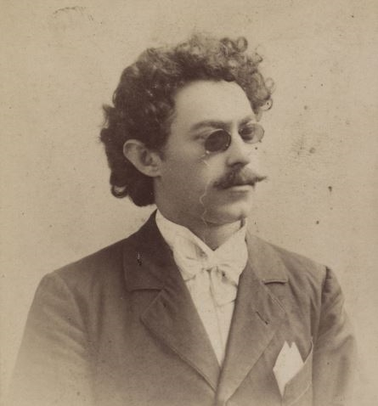
Notes:
Image accessed on March 19, 2022. https://web.nli.org.il/sites/NLI/English/library/news/newsletter/2014/March-2014/Pages/Tchernikovsky.aspx

Slide 7
Naphtali Herz Imber: 1856-1909
Born in Zloczow, Galicia, Austria-Hungary, Herz Imber had a traditional Jewish upbringing where he learned Talmud.
Eventually he found himself traveling in Palestine with Lawrence Oliphant, a British, Christian Zionist.
It was on this trip that he wrote the famous poem “Tikvateinu,” whose first stanza became the lyrics of the Israeli national anthem, with some minor changes from educator David Yellen who wrote the words of the anthem that we sing.
Notes:
Maital, S. “Hatikvah: the real story behind Israel’s national anthem.” Accessed on May 21, 2022. https://www.neaman.org.il/Files/Hatikva-The%20Real%20Story%20behind%20Israels%20anthem_20180709094501.208.pdf?msclkid=0af1fae8d0ea11ecb05be3744aa0bf7f

Slide 8
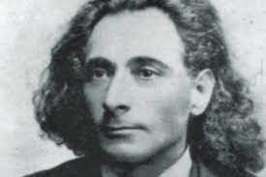
Notes:
Image accessed on March 19, 2022. https://web.nli.org.il/sites/NLI/English/library/news/newsletter/2014/March-2014/Pages/Tchernikovsky.aspx

Slide 9
Mahmoud Darwish: 1941-2008
Born in the village of al-Birwa in the Western Galilee, Darwish’s family fled to Lebanon in 1948, returning to Akko a year later.
He published his first book of poetry at the age of 19 and later left Israel to study in the Soviet Union, traveling to Egypt and Lebanon and joined the PLO (Palestinian Liberation Organization).
Darwish published more than 30 volumes of poetry, was the editor of several periodicals and literary magazines in Israel.
Although he is often thought of as the Palestinian national poet, Darwish spent most of his adult life living outside of Israel/Palestine.
Notes:
The ICenter. (2020). Israel: voices from within. Third Place Publications. 199.

Slide 10
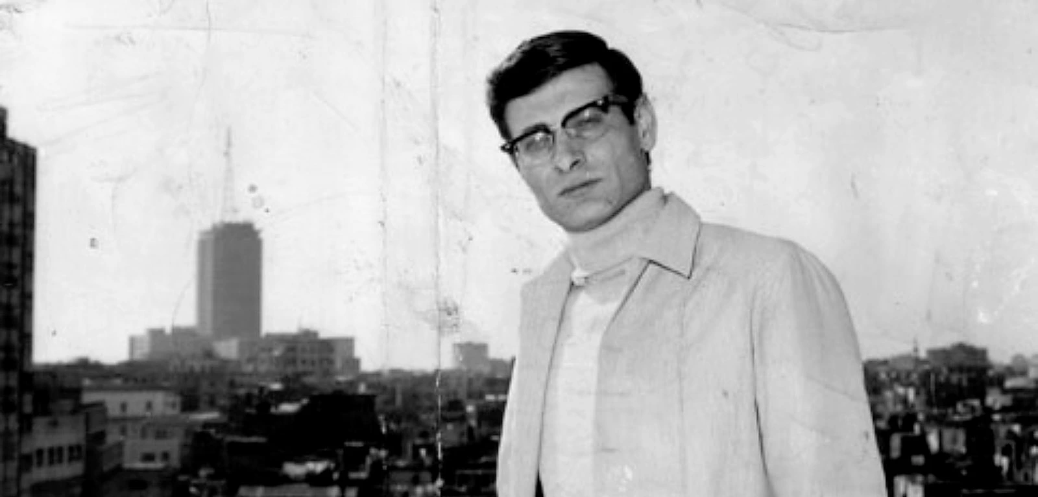
Notes:
Accessed on March 20, 2022. https://www.nybooks.com/articles/2020/02/27/mahmoud-darwish-this-land-is-mine/

Slide 11
Ayat Abou Shmeiss: 1984-
She was born in Jaffa.
Shmeiss published her first book of poetry, A Basket Full of Silent Languages, in both Arabic and Hebrew, in 2013.
Her second book, I am Two, was published in 2018, both receiving critical acclaim.
Shmeiss writes about her daily life and her experiences as a feminist, Muslim woman living in Jaffa.
Notes:
Accessed on March 20, 2022. https://en.wikipedia.org/wiki/Ayat_Abou_Shmeiss

Slide 12
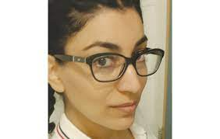
Notes:
Image accessed on March 19, 2022. https://web.nli.org.il/sites/NLI/English/library/news/newsletter/2014/March-2014/Pages/Tchernikovsky.aspx

Slide 13
Eliaz Cohen: 1972-
Born in Petah Tikvah in 1976, Cohen was raised in a religious-Zionist family and grew up in the settlement of Elkana.
As a child, Cohen studied Arabic and had friends in the neighboring Arab villages.
These experiences led Cohen to create a program for “humane checkpoint conduct” and train his fellow soldiers during his IDF service.
Cohen serves as the editor for Mashiv Haruach, a journal that attempts to address the religious and moral issues related to post-1967 Israel.
His poetry exemplifies a classic Jewish motif of “arguing with God.”
Notes:
The ICenter. (2020). Israel: voices from within. Third Place Publications. 181.

Slide 14
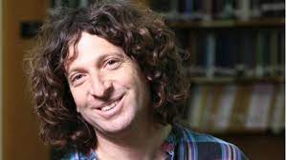
Notes:
Image accessed on March 19, 2022. https://web.nli.org.il/sites/NLI/English/library/news/newsletter/2014/March-2014/Pages/Tchernikovsky.aspx

Slide 15
Rahel Bluwstein (Rahel the Poet): 1890-1931
Born in Saratov, in Imperial Russia, Rahel the Poet grew up in an affluent family and died at the age of 41 from tuberculosis in Tel Aviv.
Her love of art, Hebrew, and poetry was developed at a Russian-speaking Hebrew primary school.
Rahel traveled to Palestine at the age of 19 and she devoted herself to learning Hebrew, studying the Bible, and became involved in the kibbutz movement.
After a short time at Kibbutz Degania in the Kinneret, Rahel moved to Tel Aviv to live out her days writing poetry.
Her writing is unique, lyrical, and combines pastoral images with colloquial Hebrew in ways unlike her contemporaries.
Notes:
The ICenter. (2020). Israel: voices from within. Third Place Publications. 35.

Slide 16
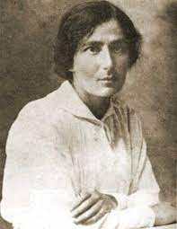
Notes:
Image accessed on March 19, 2022. https://web.nli.org.il/sites/NLI/English/library/news/newsletter/2014/March-2014/Pages/Tchernikovsky.aspx

Slide 17
Unit 2 Poets

Slide 18
Adi Keissar: 1981-
Keissar, a contemporary Israeli poet, has emerged as an important voice in Mizrahi poetry.
Keissar, whose family immigrated from Yemen, refers to her poetry as Ars Poetica—meaning ”the art of poetry” and also a play on the derogatory term, “ars” which Israelis often call Mizrahi men.
With her poetry, Keissar hopes to catalyze Mizrahi creation and culture as a important and dynamic voice in Israeli life.
Notes:
The ICenter. (2020). Israel: voices from within. Third Place Publications. 209.

Slide 19
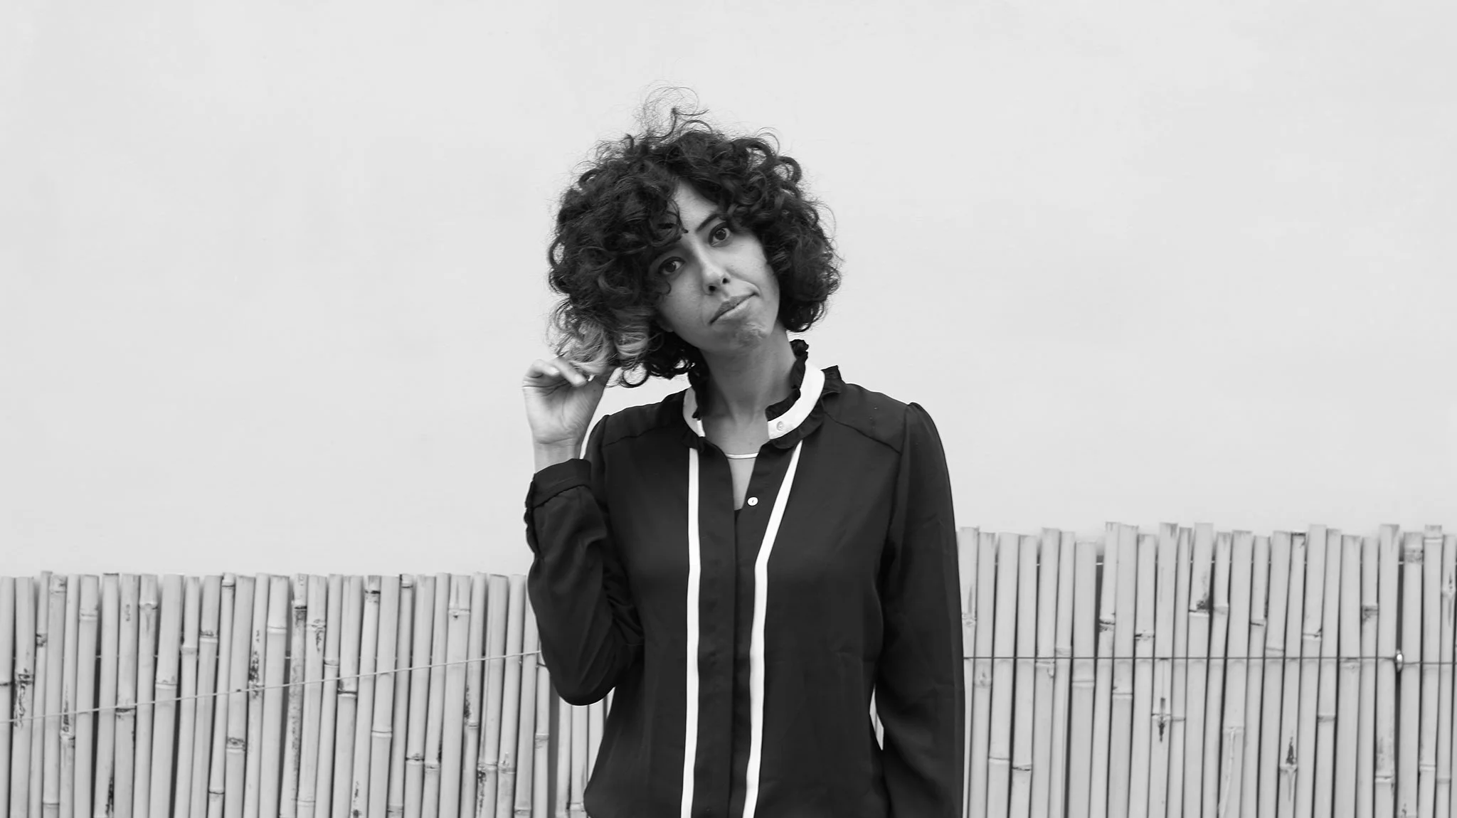
Notes:
Accessed on March 20, 2022. https://www.haaretz.com/life/books/who-s-who-who-s-an-arab-who-s-a-jew-1.5357756

Slide 20
Agi Mishol: 1946-
Mishol was born in Romania in 1946, and she immigrated to Israel as a young girl.
Mishol has written many books of poetry, which are highly regarded and have won many prizes.
She lives on a farm, growing persimmons and peaches, near Gedera.
Mishol’s poetry paints colorful pictures of the landscape of modern Israel.
Notes:
The ICenter. (2020). Israel: voices from within. Third Place Publications. 153.

Slide 21
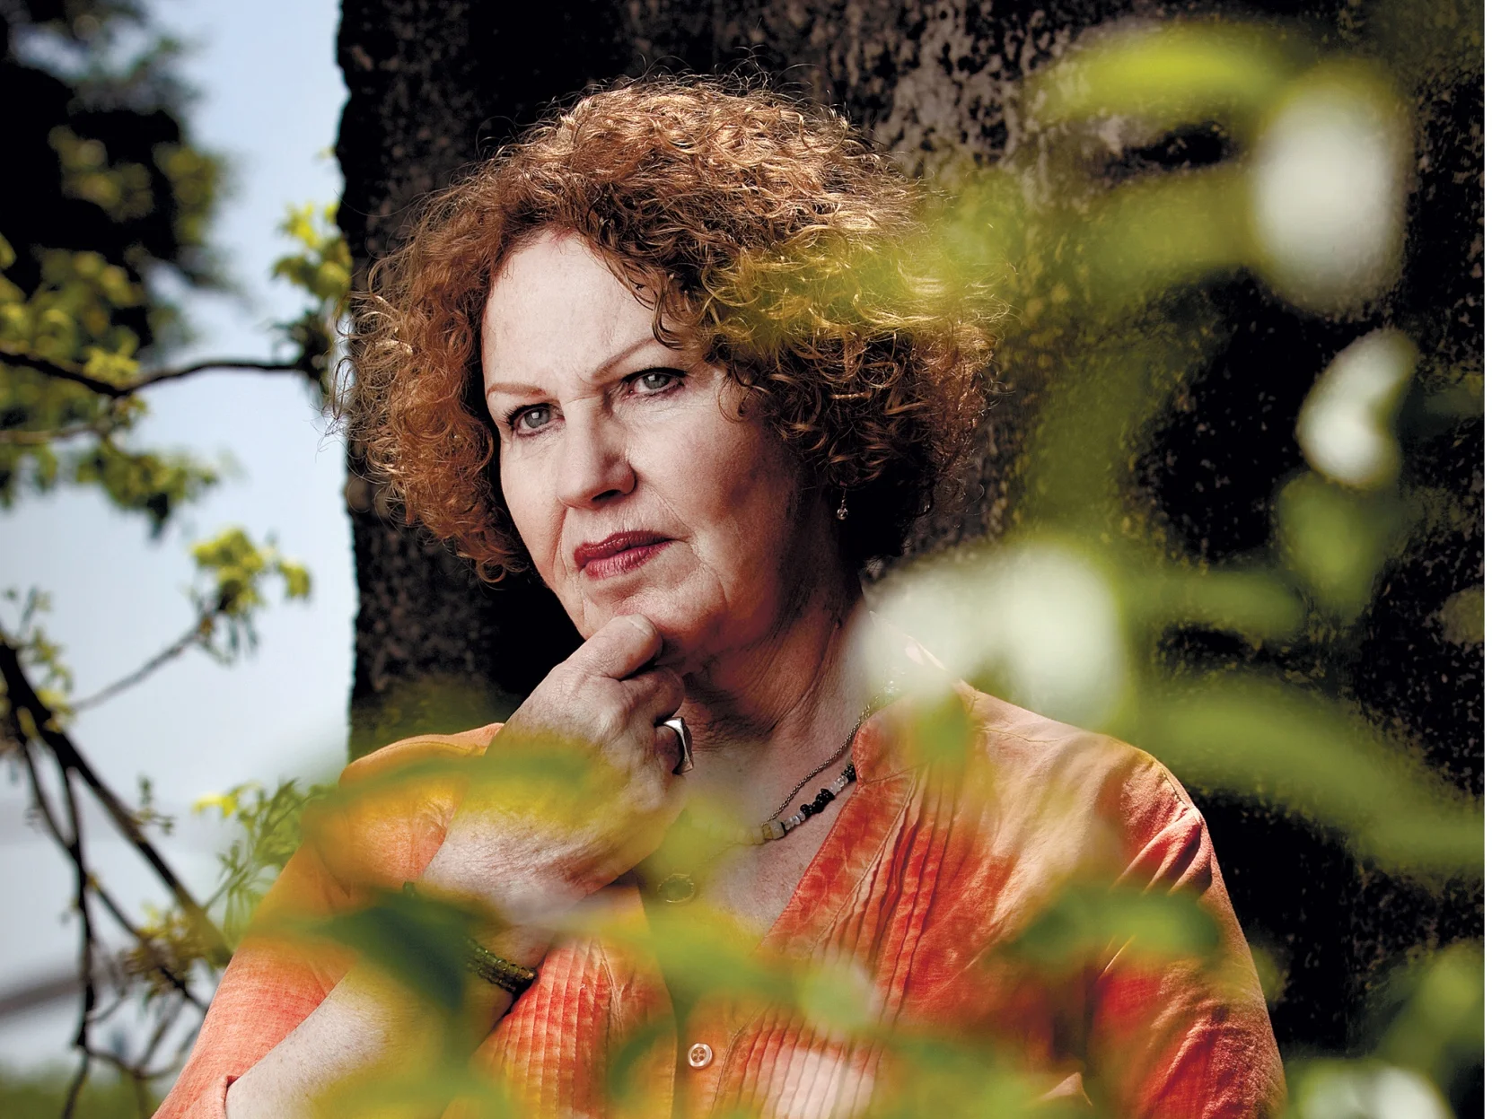
Notes:
Accessed on March 20, 2022. https://www.haaretz.com/life/books/who-s-who-who-s-an-arab-who-s-a-jew-1.5357756

Slide 22
Yehuda Amichai: 1924-2000
Amichai was born in Germany in 1923, as Ludwig Pfeuffer. He later Hebraized his family name in 1946.
Amichai was raised in an Orthodox environment, but eventually adopted a secular lifestyle. This allowed him to understand and appreciate traditional Jewish texts, and he often incorporated their imagery into his works.
Amichai’s work was not only influential in Israel, but he became a significant literary figure of the 20th century.
Notes:
The ICenter. (2020). Israel: voices from within. Third Place Publications. 107.

Slide 23
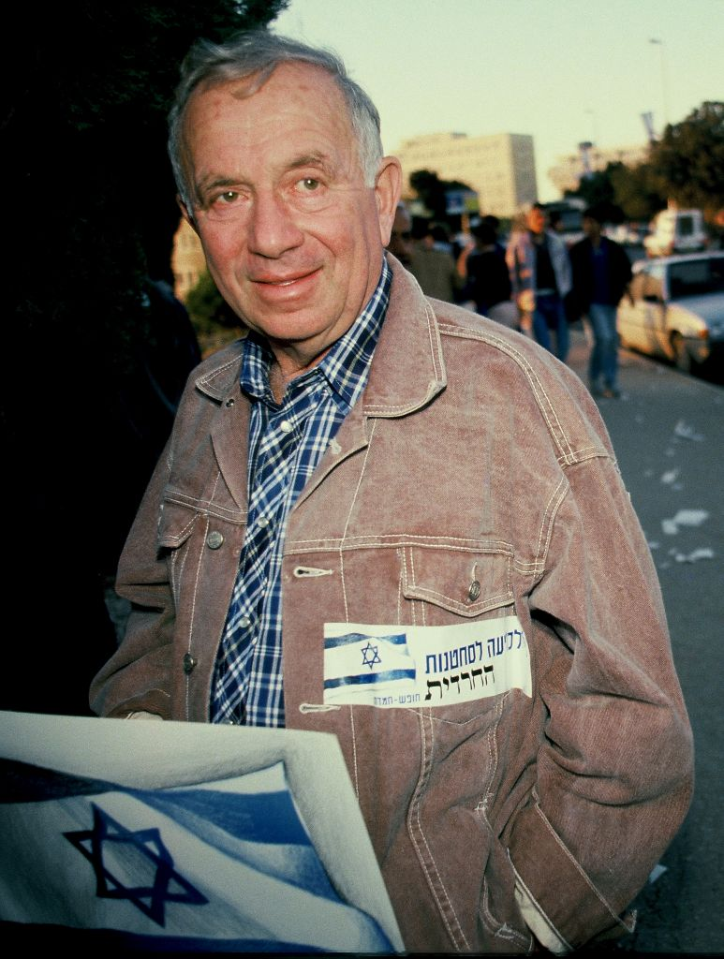
Notes:
Accessed on March 20, 2022. https://www.haaretz.com/life/books/who-s-who-who-s-an-arab-who-s-a-jew-1.5357756

Slide 24
Zelda Mishkowsky--Zelda: 1916-1984
Known just as Zelda, Zelda was born in 1916 in the Ukraine, and was descended from the Chabad Lubavitcher.
Zelda immigrated to Palestine when she was 12 and lived most of her life in Jerusalem.
Despite her religious background, Zelda’s poetry was able to traverse the divide between religious and secular Israelis; her works were admired and loved across all of Israeli society.
When Zelda moved to the religious neighborhood of Sha’areh Hesed, in Jerusalem, which is next to secular Rechavia, her house became a meeting ground for both the religious and non-religious.
Notes:
The ICenter. (2020). Israel: voices from within. Third Place Publications. 137.

Slide 25
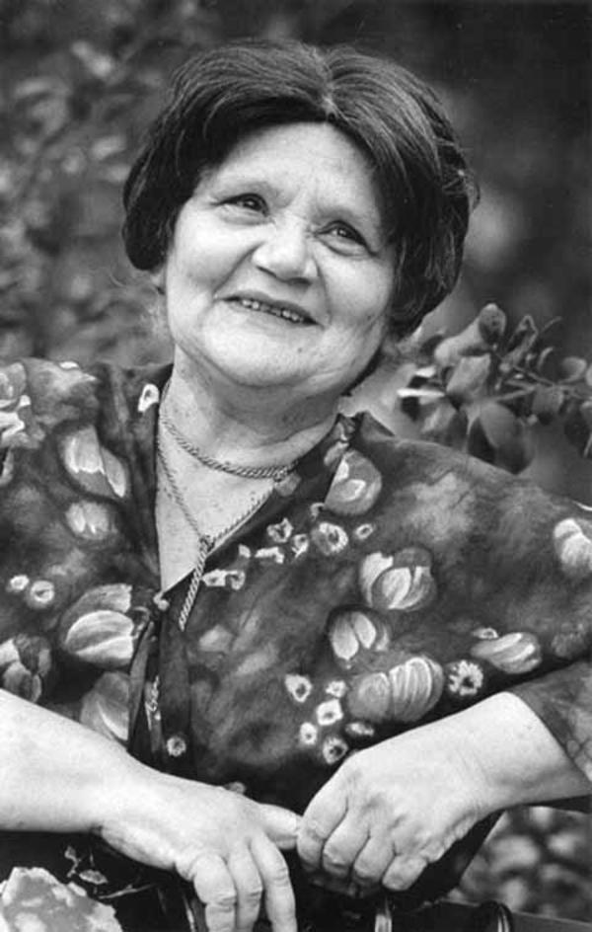
Notes:
Falk, Marcia. "Zelda." Shalvi/Hyman Encyclopedia of Jewish Women. 31 December 1999. Jewish Women's Archive. (Viewed on March 20, 2022) <https://jwa.org/encyclopedia/article/zelda>.

Slide 26
Erez Biton: 1942-
Born in 1942 in Oran, Algeria to Moroccan parents, Biton’s family fled to the city of Lod in 1948.
When he was 11, Biton lost his vision and left hand due to a grenade.
Biton has a MA in psychology from Bar Ilan University.
Biton often writes about the difficulties his immigrant group faces in modern Israeli life and about the experience of North African Jews finding their place in Israel.
Notes:
The ICenter. (2020). Israel: voices from within. Third Place Publications. 163.

Slide 27
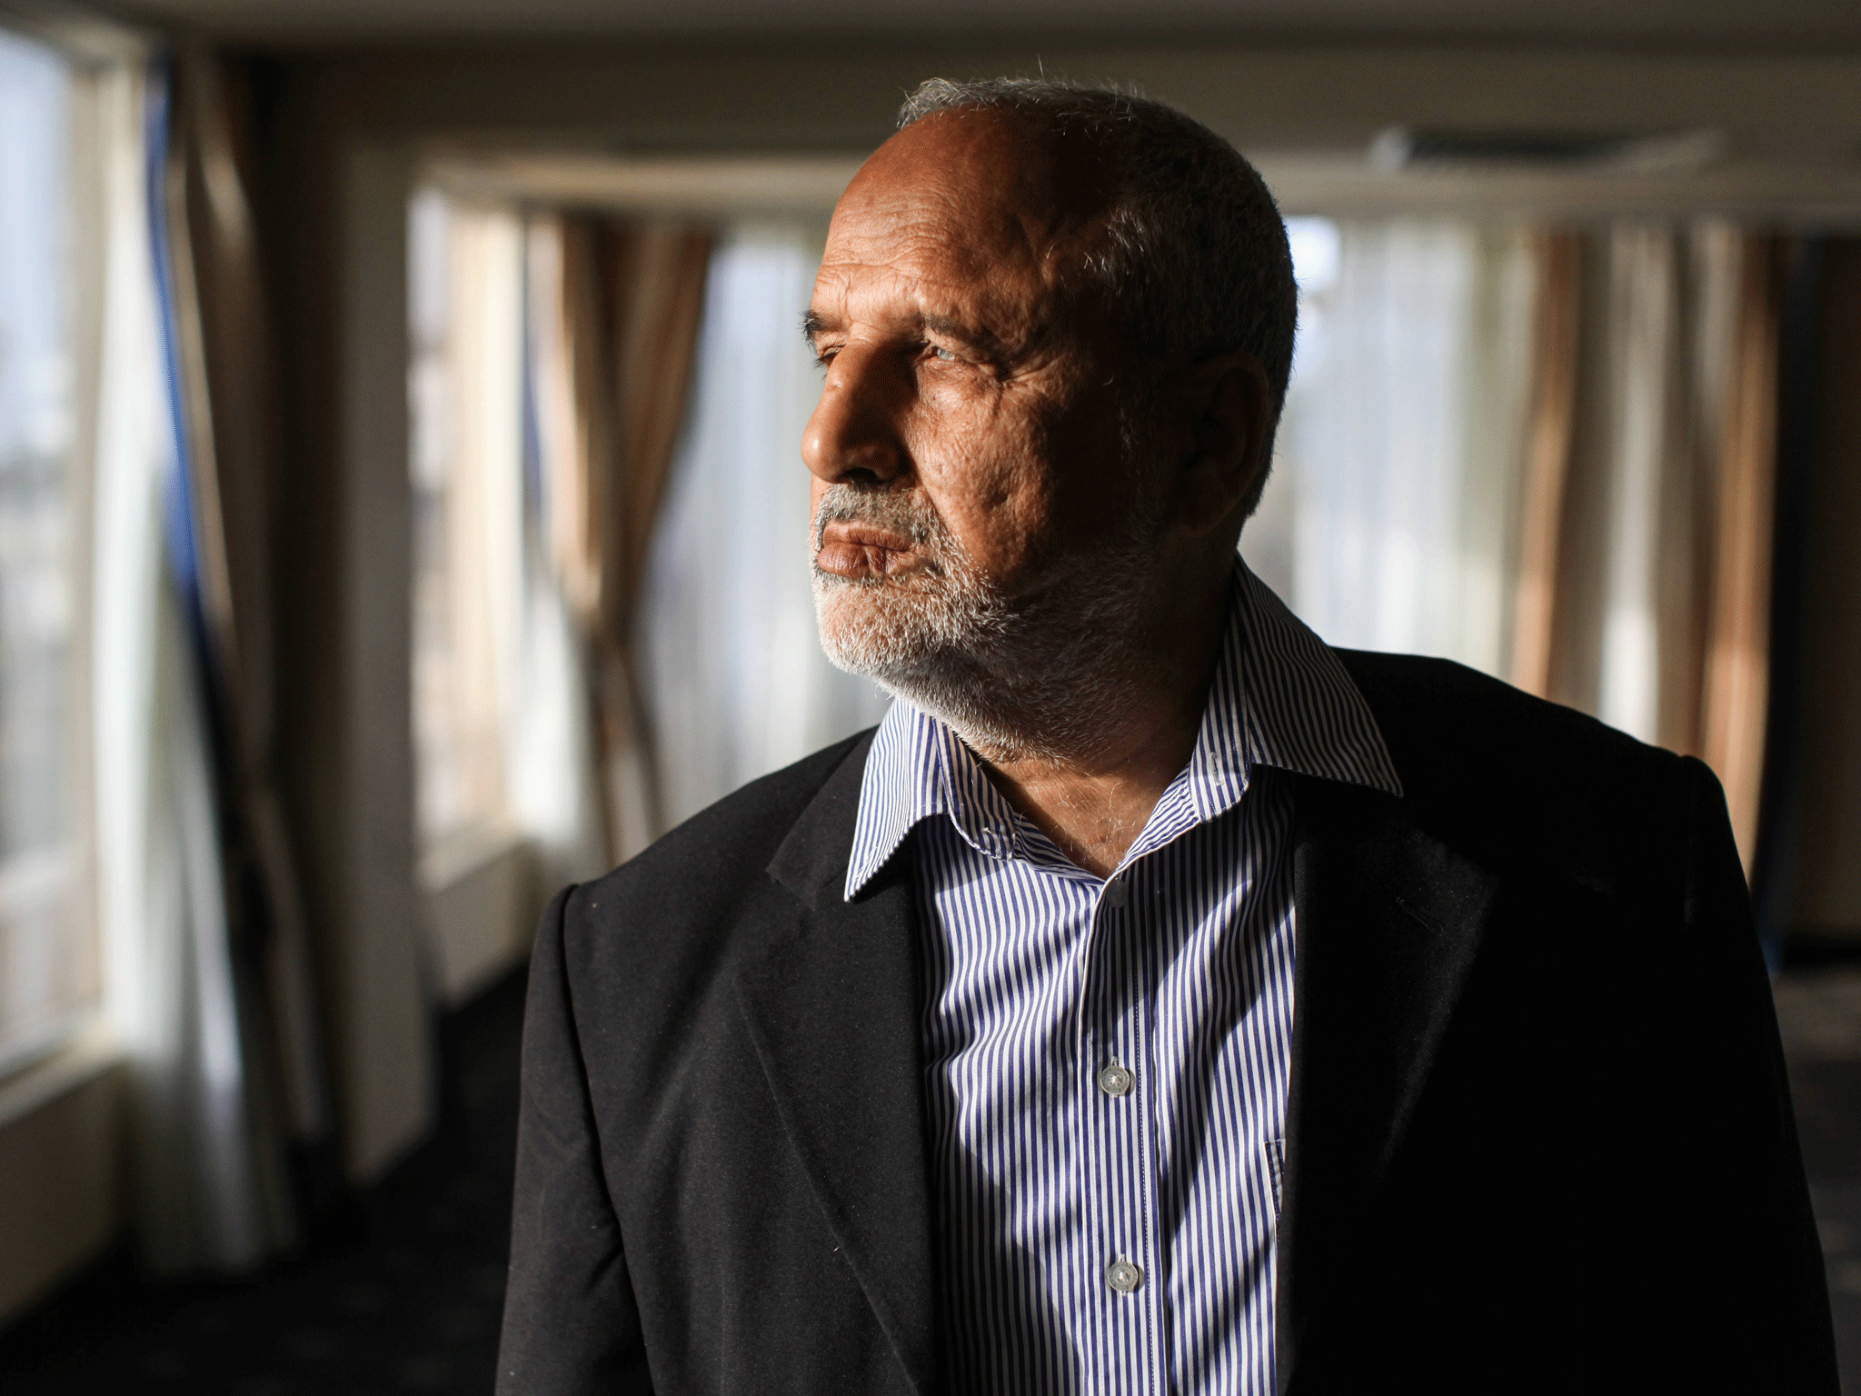
Notes:
Accessed on March 20, 2022. https://www.haaretz.com/.premium-erez-bitons-burst-of-creativity-1.5356909

Slide 28
Unit 3 Poets

Slide 29
Salman Masalha: 1953-
Masalha was born in 1953 in the town of al-Maghar, in the Galilee, to a Druze family.
He moved to Jerusalem in 1972 to receive his PhD in Arabic literature at the Hebrew University.
Masalha writes poetry in both Hebrew and Arabic, and also translates poetry into both languages.
Masalha writes frequently for Ha’Aretz and Al-Hayat. His book, In Place, won the Prime Minister’s Award in 2008.
Notes:
The ICenter. (2020). Israel: voices from within. Third Place Publications. 177.

Slide 30
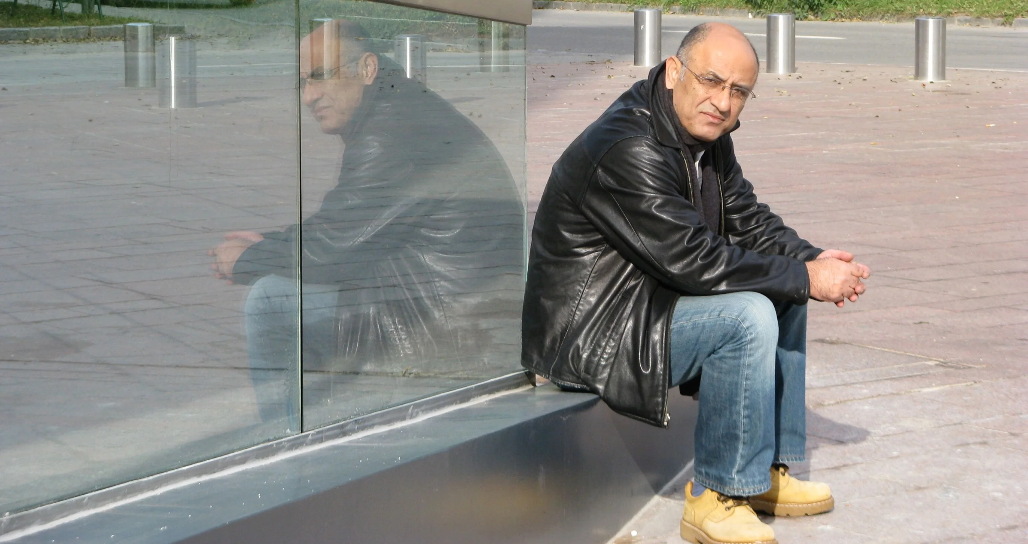
Notes:
Accessed on March 20, 2022. https://www.haaretz.com/life/books/.premium-poem-of-the-week-apartment-called-homeland-1.5241039

Slide 31
Ronny Someck: 1951-
Someck was born in Baghdad and immigrated to Israel as a young child.
He studied Hebrew literature and philosophy at Tel Aviv University, and has also taught literature there.
Someck is also a well-regarded painter, as well as a celebrated poet.
Someck combines Hebrew, Palestinian Arabic, and the Iraqi Jewish language into his poetry, weaving those languages and cultures together to create vivid poetry about contemporary Tel Aviv.
Notes:
The ICenter. (2020). Israel: voices from within. Third Place Publications. 193.

Slide 32
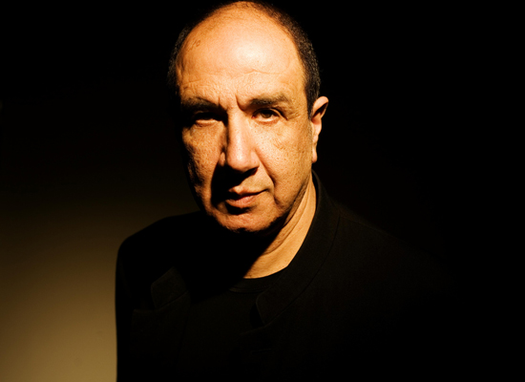
Notes:
Accessed on March 20, 2022. https://www.haaretz.com/life/books/.premium-poem-of-the-week-apartment-called-homeland-1.5241039

Slide 33
Taha Muhammad Ali: 1931-2011
Born in 1931 in the Galilee village of Saffuriyya, Ali grew up in a very traditional Palestinian home and did not attend school past the age of four.
In 1948, Ali and his family were forced to flee to Lebanon, and when they returned, they found their village destroyed.
Ali and his family opened a shop in Nazareth, selling falafel, then groceries, and finally souvenirs.
He taught himself classical Arabic texts and eventually taught himself English and did not begin writing poetry until he was 52 years old.
His poetry is often read as poetry of resistance, and his poetry often possesses a biting yet often funny tone.
Notes:
Accessed on March 20, 2022. https://www.jpost.com/jerusalem-report/israel/taha-muhammad-ali-1931-2011

Slide 34
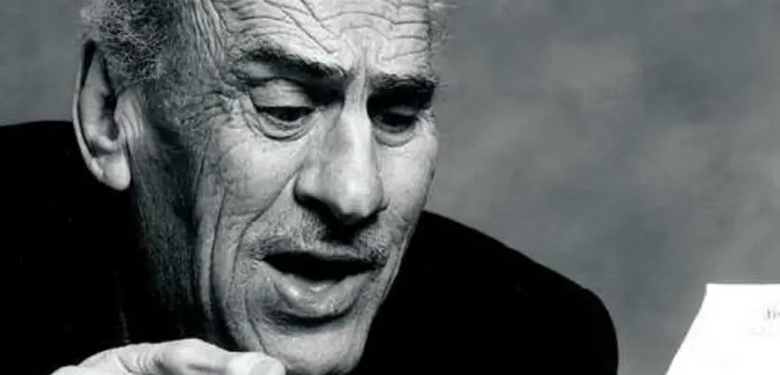
Notes:
Accessed on March 20, 2022. https://www.jpost.com/jerusalem-report/israel/taha-muhammad-ali-1931-2011

Slide 35
Meir Wiezeltier: 1941-
Born in Moscow in 1941, during the war, Wiezeltier grew up living as a displaced person in Poland, Germany, and France.
He ultimately moved to Netanya to live on a kibbutz in 1955, and then moved to Tel Aviv at age 14.
He published his first poems at the age of 18 and went on to be a central figure in poetry in Tel Aviv in the 1960s.
Wiezeltier also translated many works of literature, including novels by Virginia Woolf and Charles Dickens, into Hebrew.
Notes:
The ICenter. (2020). Israel: voices from within. Third Place Publications. 143.

Slide 36
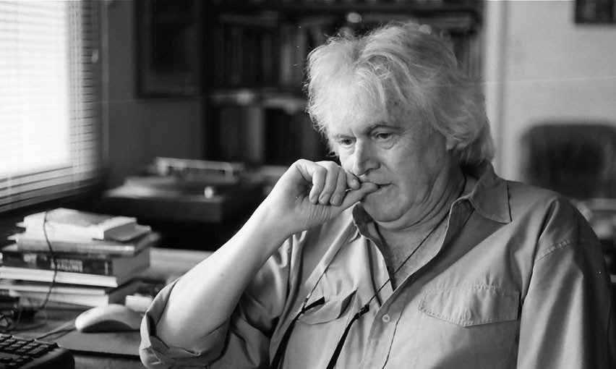
Notes:
Accessed on March 20, 2022. https://tlv1.fm/wp-content/uploads/2016/09/Meir-Wieseltier-e1473174889456.jpg

