Slide 1
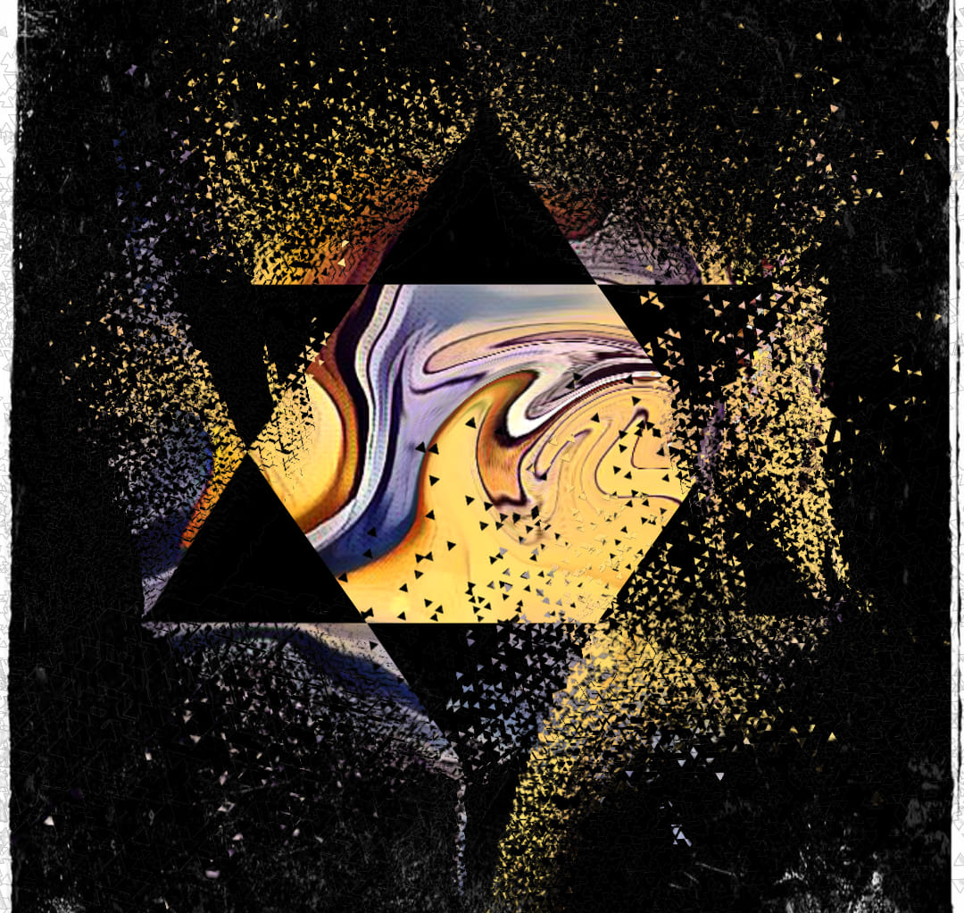
תפילת אומנות
T’filat Omanut
An artistic siddur. All art and kavanot has been created by Tzvia Rubens

Slide 2
Baruch atah, Adonai Eloheinu, Melech haolam, asher kid'shanu b'mitzvotav, v'tzivanu l'hadlik ner shel Shabbat.
הדלקת נרות
Candle Blessings
בָּרוּךְ אַתָּה, יְיָ אֱלֹהֵֽינוּ, מֶֽלֶךְ הָעוֹלָם אֲשֶׁר קִדְּשָֽׁנוּ בְּמִצְוֺתָיו וְצִוָּֽנוּ לְהַדְלִיק נֵר שֶׁל שַׁבָּת
Blessed are you, Holy Energy of the Universe, who sanctifies us with mitzvot, commanding us to light the Sabbath candles

Slide 3
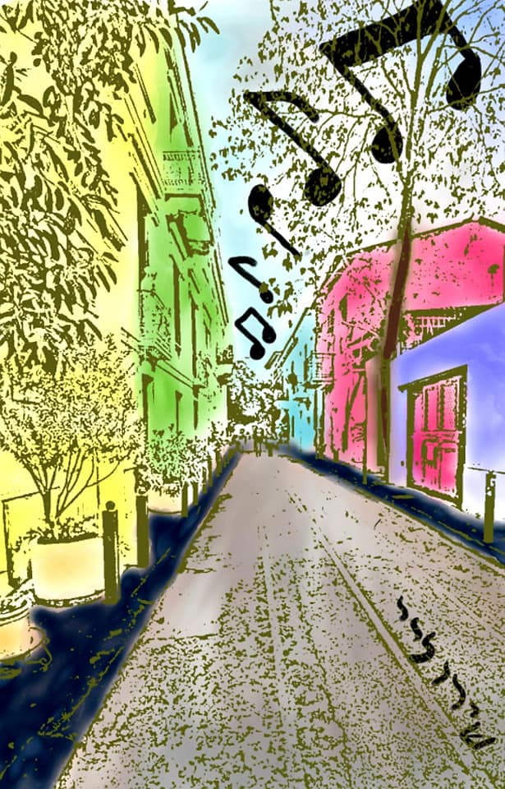
שירו לייShiru L’Adonai
Bless, laud, exult, and praise –
With all our hearts we cry out to You!
The Holy One who has given us music,
To proclaim our love for You –
We raise up our voices to every nation,
To all peoples, to all without hope!
You are ETERNAL,
Held in awe by the Divine Council,
Whose majesty reigns supreme.
Let the mighty oaks know before whom they stand,
And let the vast oceans know their Creator!
All the earth will sing out to You,
Divine Conductor of the infinite symphony,
The one who arranges our voices,
And puts life into order.
Blessed are You, who has given us song by which to praise You!

Slide 4
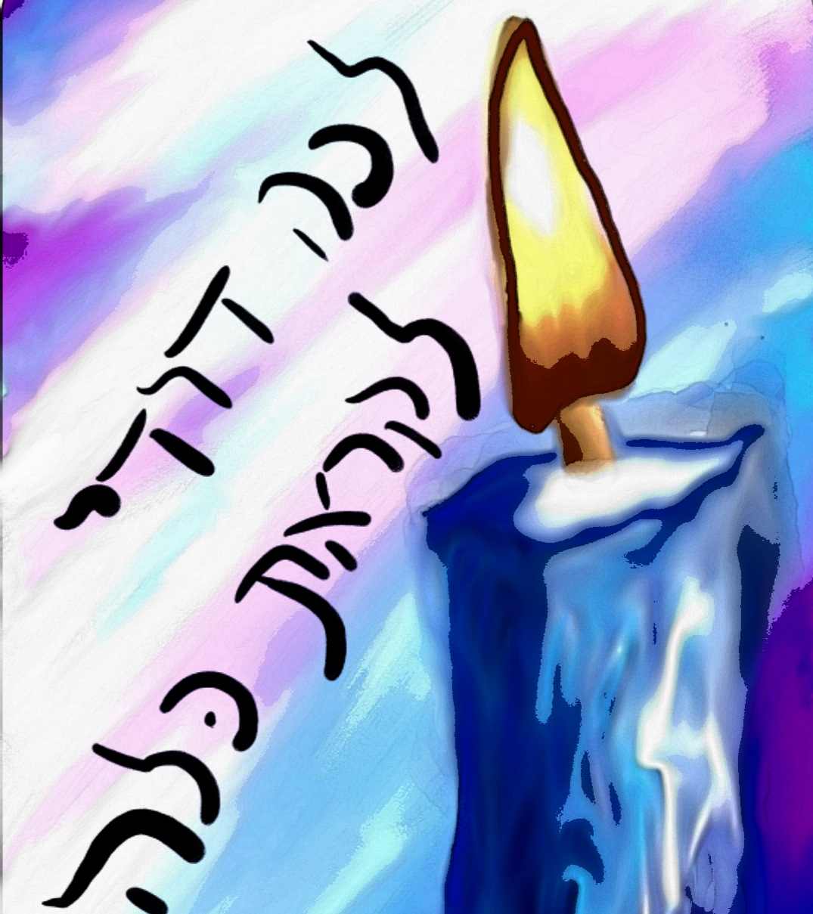
Lecha Dodi לכה דודי

Slide 5
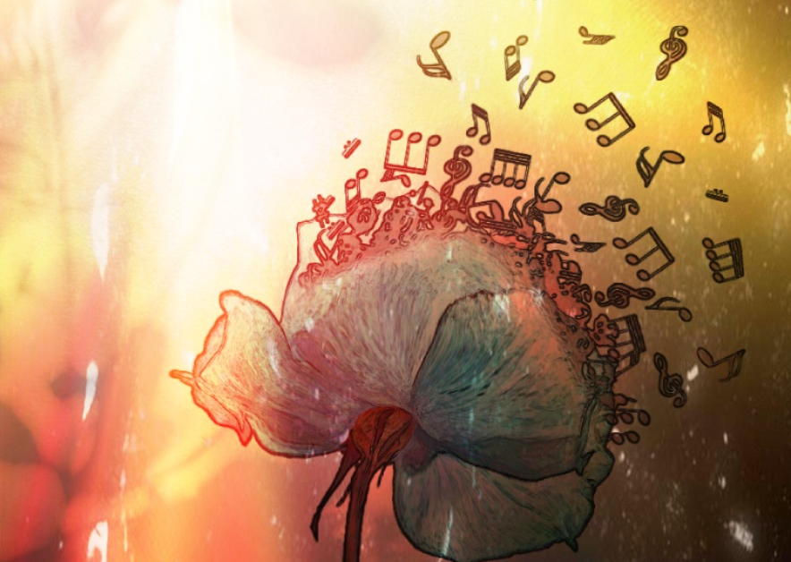
Shabbat Has Arrived in Our City
Shabbat has arrived in our city
We give thanks for this time
Shabbat has arrived in our city
Please God, bless me with your light
I’ll gather it thrice,
Oh no, not once, not twice
As the lights begin to flicker
They’ll dance and then ill whisper
Holy, holy, holy, are You –
[chorus]
This week has come and gone
But now we say that we’re done
As we put away our strife’s
And we bask in God’s light, singing
Shalom, Shalom, Shalom
[chorus]

Slide 6
שלום עליכם
Shalom Aleichem
שָׁלוֹם עֲלֵיכֶם מַלְאֲכֵי הַשָּׁרֵת מַלְאֲכֵי עֶלְיוֹן מִמֶּלֶךְ מַלְכֵי הַמְּלָכִים הַקָּדוֹשׁ בָּרוּךְ הוּא בּוֹאֲכֶם לְשָׁלוֹם מַלְאֲכֵי הַשָּׁלוֹם מַלְאֲכֵי עֶלְיוֹן מִמֶּלֶךְ מַלְכֵי הַמְּלָכִים הַקָּדוֹשׁ בָּרוּךְ הוּא בָּרְכוּנִי לְשָׁלוֹם מַלְאֲכֵי הַשָּׁלוֹם מַלְאָכֵי עֶלְיוֹן מִמֶּלֶךְ מַלְכֵי הַמְּלָכִים הַקָּדוֹשׁ בָּרוּךְ הוּא צֵאתְכֶם לְשָׁלוֹם מַלְאֲכֵי הַשָּׁלוֹם מַלְאָכֵי עֶלְיוֹן מִמֶּלֶךְ מַלְכֵי הַמְּלָכִים הַקָּדוֹשׁ בָּרוּךְ הוּא
Sha-lom a-lei-chem, mal-a-chei ha-sha-reit, mal-a-chei el-yon, mi-me-lech ma-l'chei ha-m'la-chim, ha-ka-dosh ba-ruch hu. Bo-a-chem l'sha-lom, mal-a-chei ha-sha-lom, mal-a-chei el-yon, mi-me-lech ma-l'chei ha-m'la-chim, ha-ka-dosh ba-ruch hu. Bar-chu-ni l'sha-lom, mal-a-chei ha-sha-lom, mal-a-chei el-yon, mi-me-lech ma-l'chei ha-m'la-chim, ha-ka-dosh ba-ruch hu. Tsei-t'chem l'sha-lom, mal-a-chei ha-sha-lom, mal-a-chei el-yon, mi-me-lech ma-l'chei ha-m'la-chim, ha-ka-dosh ba-ruch hu.

Slide 7
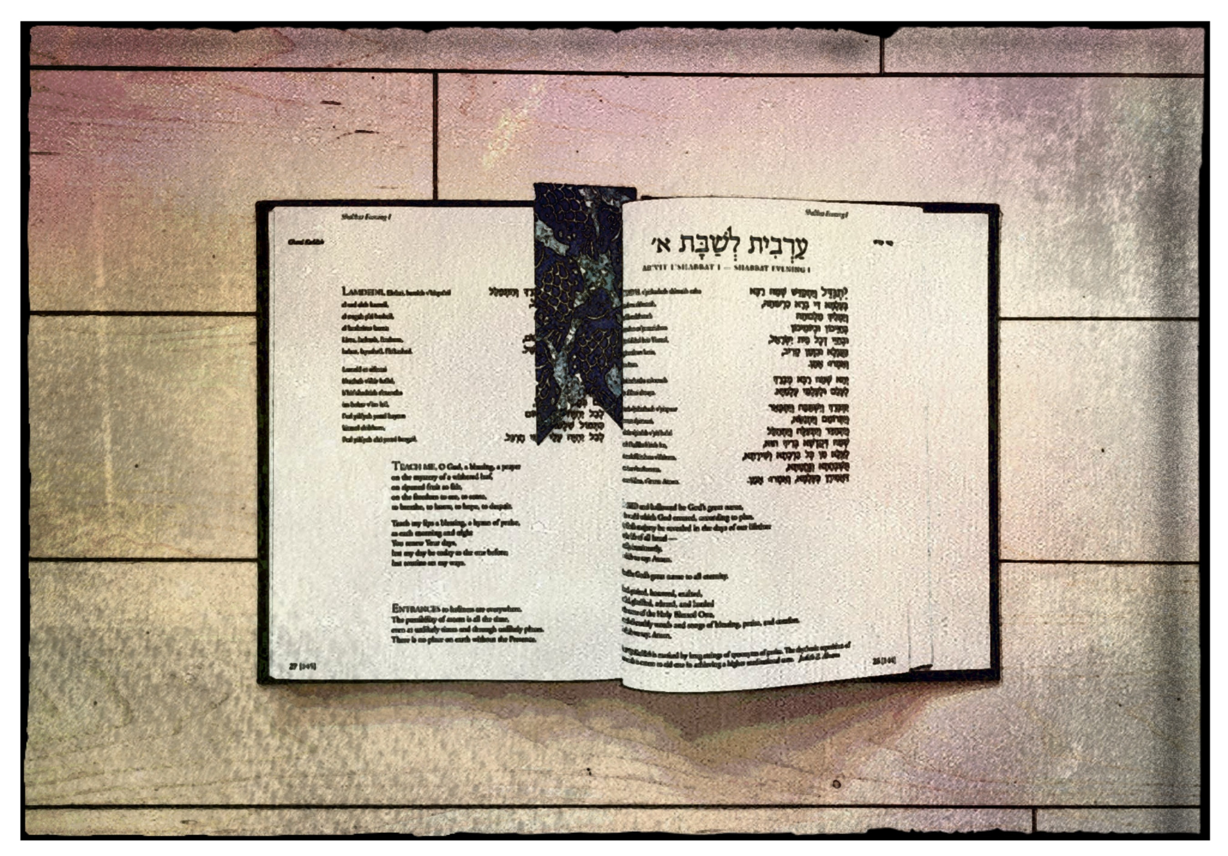
Chatzi Kaddish חצי קדיש
Holy Author, whose story is enticing, You have given us song – and you have given us space to ready ourselves, to be in conversation, with You. So often our lips utter thoughts not fully formed. Our gratitude is often mixed with resentment. But hear us, Mighty Scribe, You, who gives us a chance to ponder, A chance to reflect, a chance to prepare. Here we are on the precipice of time, Leaving the space of internal congestion, As we embrace our conversations with You. Life has been hard, life has been wonderful, I just need to be heard. Here we are, a bookmark between the noise and the conversation, Ready to engage.

Slide 8
ברכו Barchu
Hear us, אל הרחמים, O Compassionate One
As we stand on the precipice of uncertainty and depletion.
Weaver of the tapestry of our lives, hear our adoration for You,
Blessed One, whose name we dare not whisper,
Your heavenly throne will reign forever!
Your name of חסידות, the One who is Kindness –
Purify our hearts that we may serve You through positive interactions.
Let us embrace the neighbor, the friend, and the stranger.
All who benefit from the corners of Your generosity,
The overflow of divinity that You have instilled within us!
Eternal Parent, accept our humble supplications,
As they ring out to heavens -
At Sinai you showed us mercy,
You showed us Your Torah, You showed us our path.
At Sinai we became Yours, and together we were one.
Blessed are You, חסידות ורחמים, The One before whom we stand.
בָּרְכוּ אֶת יְיָ הַמְבֹרָך
בָרוּךְ יְיָ הַמְבֹרָךְ לְעוֹלָם וָעֶד

Slide 9
מעריב ערבים
Ma’ariv Aravim

Slide 10
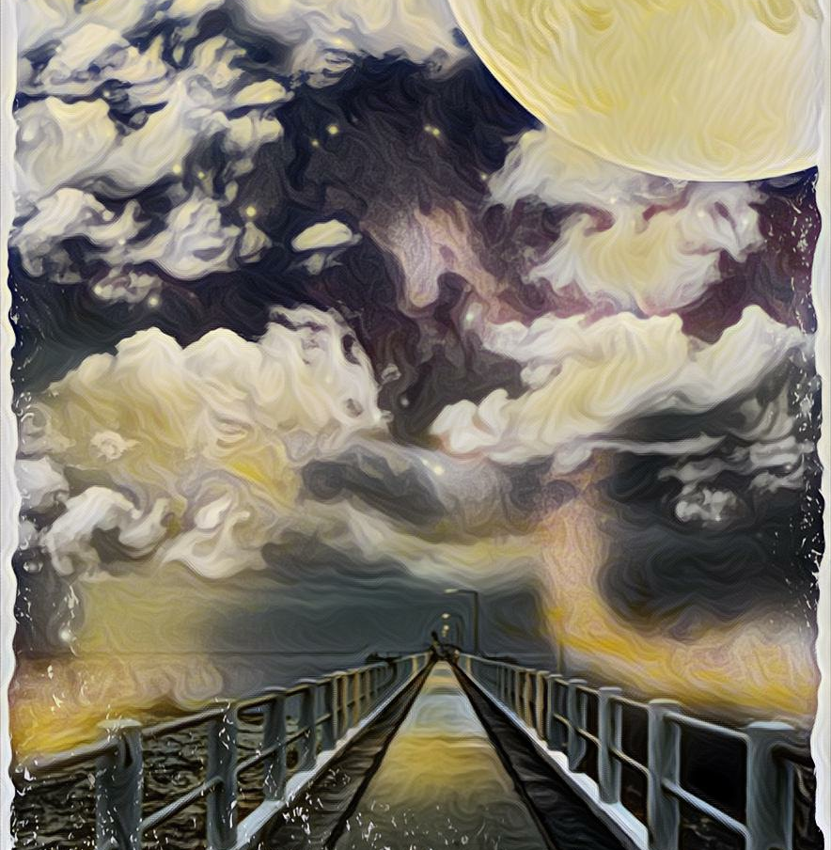
אהבת עולם
Ahavat Olam
Eternal is Your loving kindness for the House of Jacob, Rachel, and Leah.
Blessed are You who watches over us each night.
When our eyes grow heavy, as the night slowly illuminates by light lifetimes away,
We meditate on your mitzvot, on Your Torah, and on Your laws.
Light has rolled into darkness, and we whisper our appreciation for another day to love, to grow, and to learn.
Blessed is the Divine Architect who lengthens our days and shows love to Your people, Israel.

Slide 11
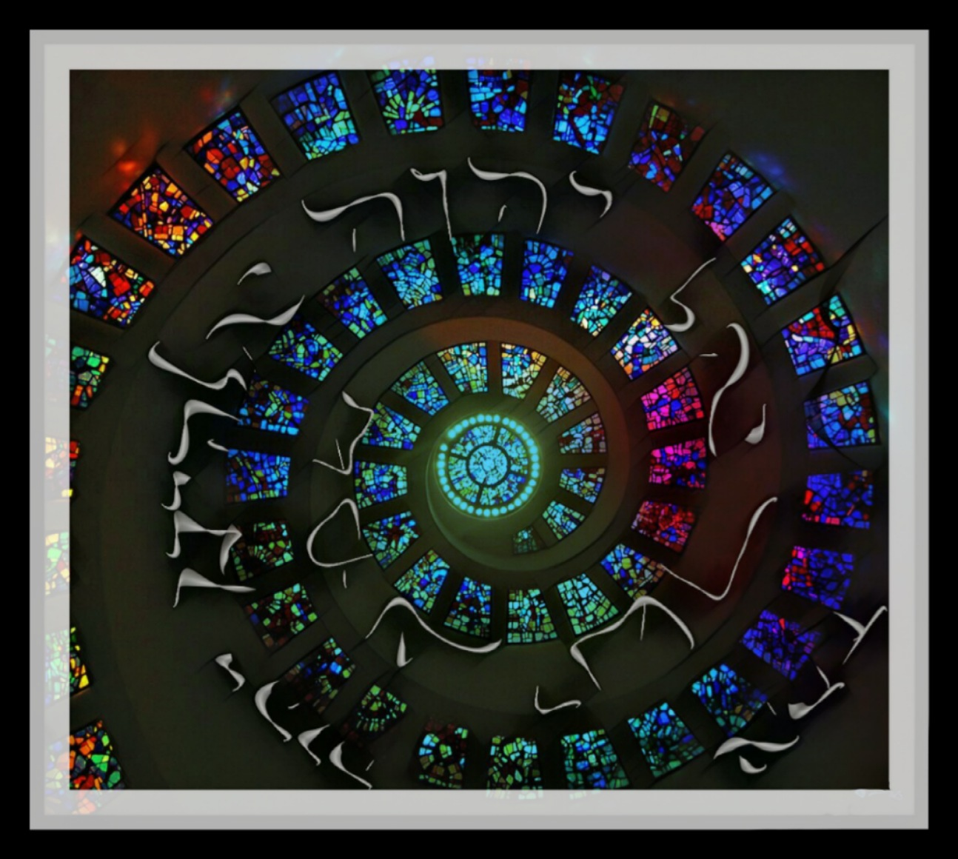
Hear me, Blessed One! Infinite is Your majesty. Your kingdom bears the fruit of devotion, for those who seek Your covenant. Extend Your wings and embrace Your people. You, who has no name, and all names – Who sat in fire and put the breath of the ETERNAL into every soul, Hear our supplications, Blessed is the Holy Energy of the Universe, who is one, now and forever!
שמע
Shema

Slide 12
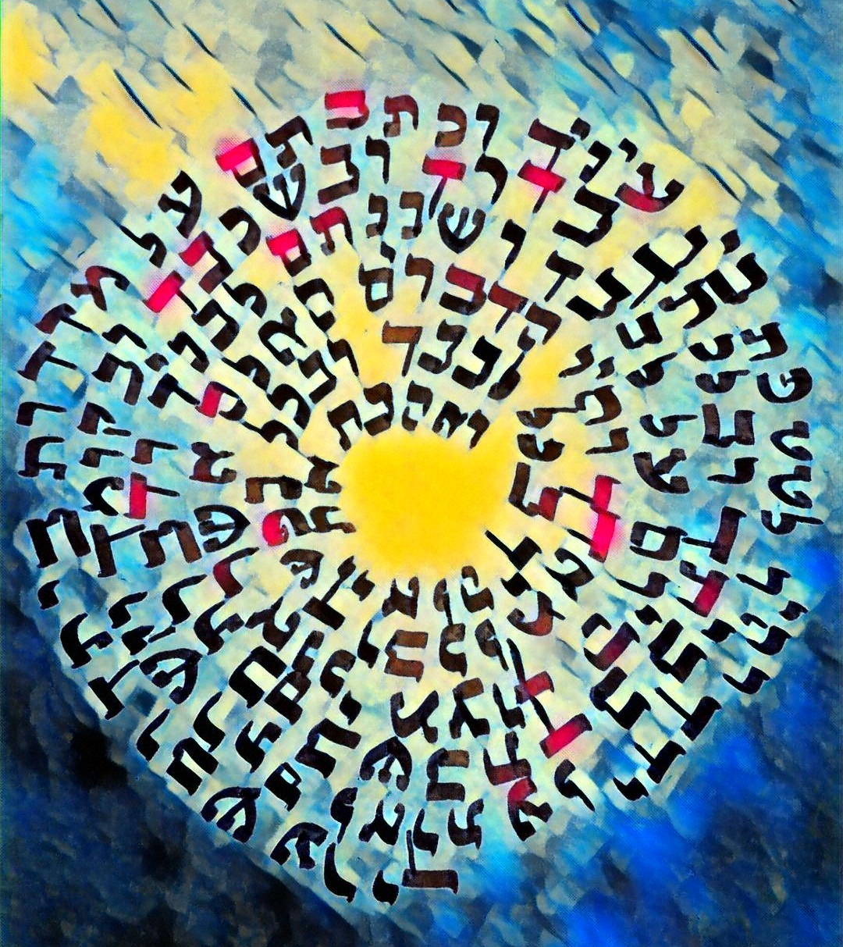
ואהבתV’ahavta
I am told to love you,
Whoever you are.
With all my heart, my soul, and my might.
Wherever I go, whomever I am with,
I should keep You with me.
I’ll be honest, God, is it?
Sometimes all I feel is confusion.
I want to be near you, to feel you –
But some days it’s just silence.
Your words hang on my doorposts,
I teach them to my kids –
But who will remind me when I feel lost?
Give me a sign so that I may wear it as I go about my way.
Help me draw nearer to You.
Blessed is the Holy Struggle as I yearn to know You

Slide 13
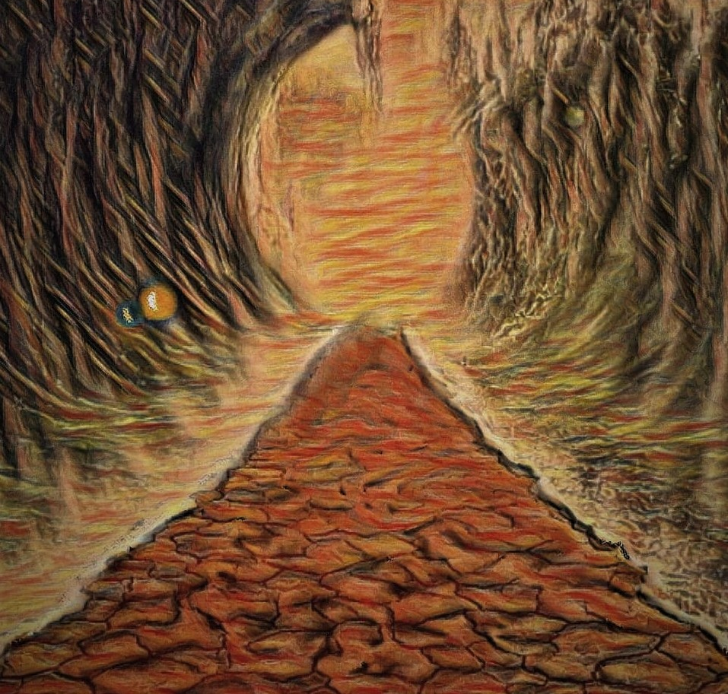
מי כמכה
Mi Chamocha
מִי-כָמֹכָה בָּאֵלִם יְהוָה מִי כָּמֹכָה נֶאְדָּר בַּקֹּדֶשׁ נוֹרָא תְהִלֹּת, עֹשֵׂה פֶלֶא
Mi Chamocha Ba'elim Adonai? Mi kamocha ne'dar bakodesh; Nora tehillot, oseh feleh.
Who is comparable to You, Oh Holy Energy of the Universe?
Who is comparable to You, who is magnificent in holiness;
And splendid are your actions, our Divine Miracle Worker!

Slide 14
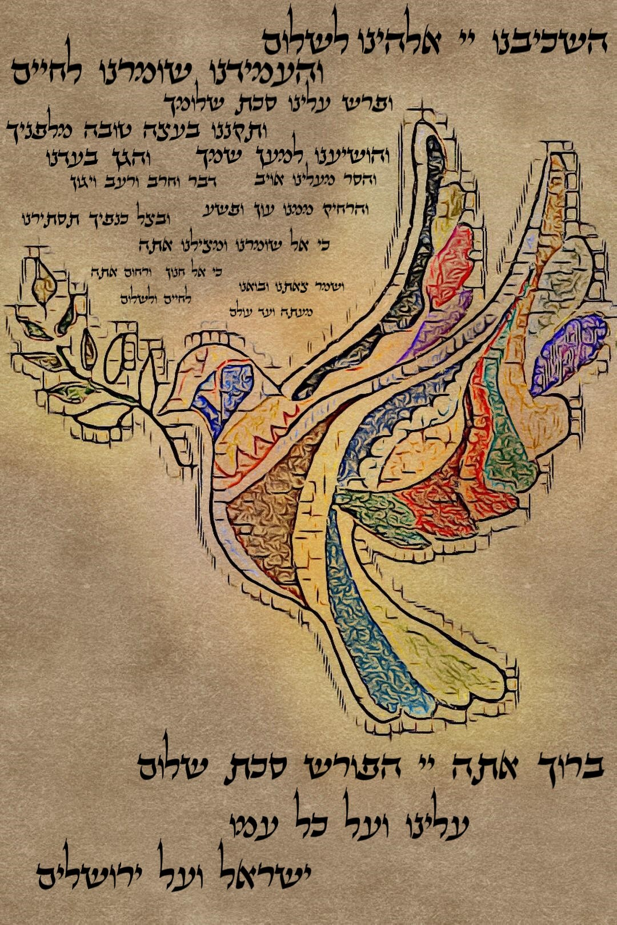
השכיבנו Hashkiveinu Shabbat has arrived in our city, The streets are frantic with last minute preparation. Will this task be finished, or that? There is too much to do, and time scares us. Yet, since the beginning, You have protected us – You have shown us Your mighty hand, and sustained us through endless miracles. You gave to us a garden, A shelter beneath your wings, You guarded us and protected us. You were a dove in the chaos of the storm, and a colorful tunic which we wore with honor. You were a shield that took our heaviest blows. Now, more than ever, we need You, Our Holy Symbol of hope – That we can pause, slow down, and appreciate Your gift to Your people. Shabbat is here, And it is only under Your protection, That we can finally let go of the chaos, and prepare our lips so that our mouths will declare Your ever-living sovereignty.

Slide 15
עמידהSilent Amidah
You are my neshama, the Eternal Flame of my heart, I sit here, my mouth open wide in preparation for speaking Your praise. Blessed are you, the One who was in relationship with my mothers and fathers. I am filled with awe as I draw closer to Your Majesty. Each droplet of rain, each sparkle of the evening stars reminds me, of You - My Infinite judge. With my breath I pray to You, Oh Eternal One - See me favorably as you did with Abraham, Isaac, and Jacob, Cherish my contributions as you did with Sarah, Rebecca, Rachel, and Leah, Trust in my strength as you did with Shifrah and Puah – As they delivered the deliverer who was slow with tongue as I am this evening. Grant me the wisdom to lead with conviction like my mothers Miriam and Deborah, Or as I find myself like Joseph in disputes with my brothers and sisters. You are showing me Your path, my Eternal Flame – Together We will walk, onwards towards holiness.

Slide 16
עושה שלום
Oseh Shalom
עוֹשֶׂה שָׁלוֹם בִּמְרוֹמָיו הוּא יַעֲשֶׂה שָׁלוֹם עָלֵינוּ וְעַל כָּל יִשְׂרָאֵל וְאִמְרוּ: אָמֵן
Oseh shalom bimromav Hu ya'aseh shalom aleinu V'al kol Yisrael V'imru: amen.

Slide 17
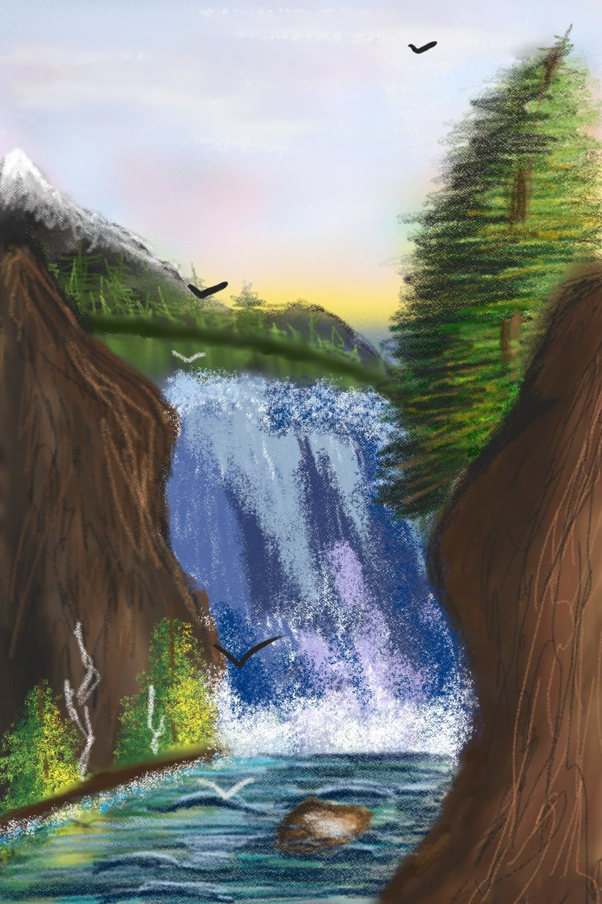
Mi Shebeirach
מי שברך
We look towards the mountains and at the majesty of Your world,
Each rock and each pebble, unstable in its own right,
But when supported by others, creating a balanced whole
Our hearts are with You, the Creator of our destinies.
We recall the thunders of Sinai that still reverberate in our souls,
The words of Your mouth drift to us from the hills of Jerusalem,
From the rivers Euphrates and Tigris to the shores of the Jordan,
The waters flow evenly, their waves engulfing all that wanders into their path, only to release it just a few moments later.
They might still be whole; but now, cracked and fractured
מי שברך אבותינו ואמותינו
תברך אותנו תזכור אותנו
May the One who blessed our fathers and our mothers,
bless us and remember us

Slide 18
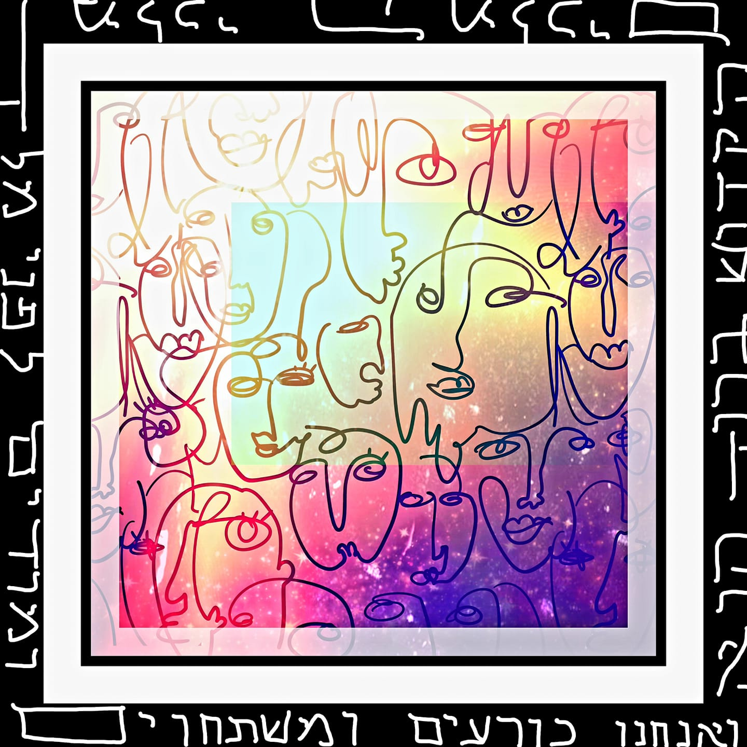
עלינו Aleinu
Hear our voice
You, who has created and continues to create diversity.
Holy are the unique nations of this world who yearn to bask in Your greatness.
We bow at the knee, taking in the grandeur of your world
Which you, our Eternal Parent formed.
Holy are You, who has breathed each soul into existence, according to your likeness
From chaos to clarity, You, Holy One, continue to shape Your world for us.
Your presence fills all space, all time, and rests within all peoples.
Sh'ma Yisrael, Adonai Eloheinu,
Adonai Echad.
Hear us as we bless your name, Architect of all Creation.

Slide 19
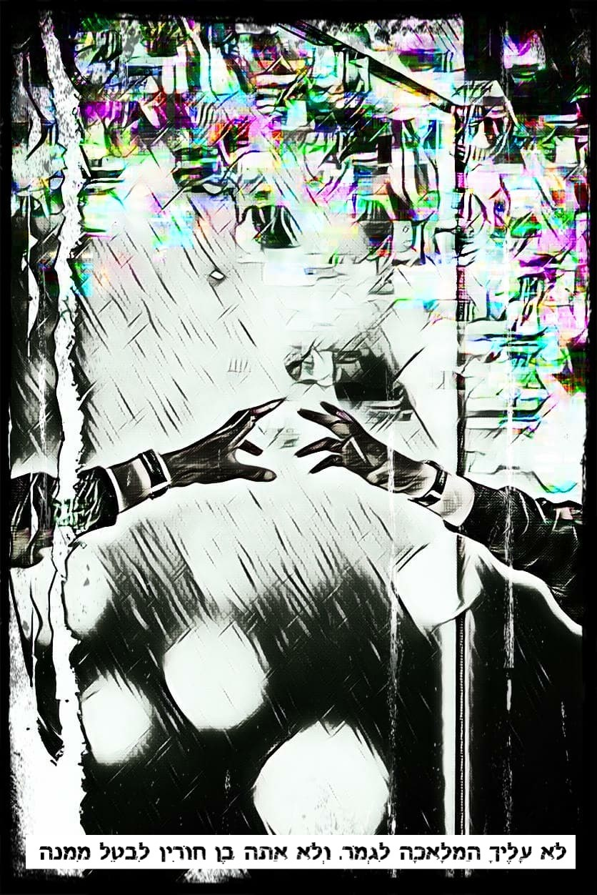
קדיש יתום
Mourner’s Kaddish
Time feels distorted, in this new world.
Bent, unwavering, unwilling to be compromised.
I made promises, I closed my eyes and prayed for a different scenario.
Now, I look in the mirror, and all I see is my reflection,
But all I want to see is you.
You who once stood next to me in life,
now I must stand beside you in death,
Escorting you to the great beyond.
Time feels distorted in this new world,
Without you.

Slide 20
V’shamru
ושמרו
וְשָׁמְר֥וּ בְנֵֽי־יִשְׂרָאֵ֖ל אֶת־הַשַּׁבָּ֑ת לַעֲשׂ֧וֹת אֶת־הַשַּׁבָּ֛ת לְדֹרֹתָ֖ם בְּרִ֥ית עוֹלָֽם
בֵּינִ֗י וּבֵין֙ בְּנֵ֣י יִשְׂרָאֵ֔ל א֥וֹת הִ֖וא לְעֹלָ֑ם
כִּי־שֵׁ֣שֶׁת יָמִ֗ים עָשָׂ֤ה יְהוָה֙ אֶת־הַשָּׁמַ֣יִם וְאֶת־הָאָ֔רֶץ
וּבַיּוֹם֙ הַשְּׁבִיעִ֔י שָׁבַ֖ת וַיִּנָּפַֽשׁ
V’shamru v'nei Yisrael et HaShabbat, laasot et HaShabbat l’dorotam b’rit olam.
Beini u’vein b’nei Yisrael ot hi l’olam,
ki sheishet yamim asah Adonai et hashamayim v’et haaretz,
u’vayom hashvi-i shavat vayinafash

Slide 21
קידוש
Kiddush
Baruch atah, Adonai Eloheinu, Melech haolam, borei p’ri hagafen.
בָּרוּךְ אַתָּה, יְיָ אֱלֹהֵֽינוּ, מֶֽלֶךְ הָעוֹלָם בּוֹרֵא פְּרִי הַגָּֽפֶן
Blessed are You, Holy Energy of the Universe, Creator of the fruit of the vine.

Slide 22
המוציא
Ha Motzi
בָּרוּךְ אַתָּה יְיָ אֱלֹהֵינוּ מֶלֶךְ הָעוֹלָם הַמּוֹצִיא לֶחֶם מִן הָאָרֶץ
Baruch atah Adonai, Eloheinu Melekh ha’olam, hamotzi lekhem min ha'aretz.
Blessed are you Adonai our God, Ruler of the universe, who causes bread to come forth from the earth

